Slide 1
One Thing Lead to Another
Mikey

Slide 2
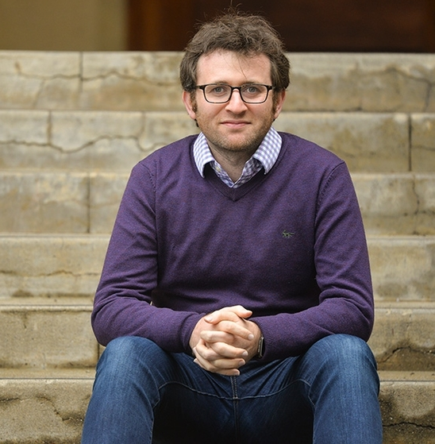
Personal Project
PhD Application
Feasible 2nd year paper
“Everybody who applies is good at school. Show you’re good at research.” — David Atkin

Slide 3
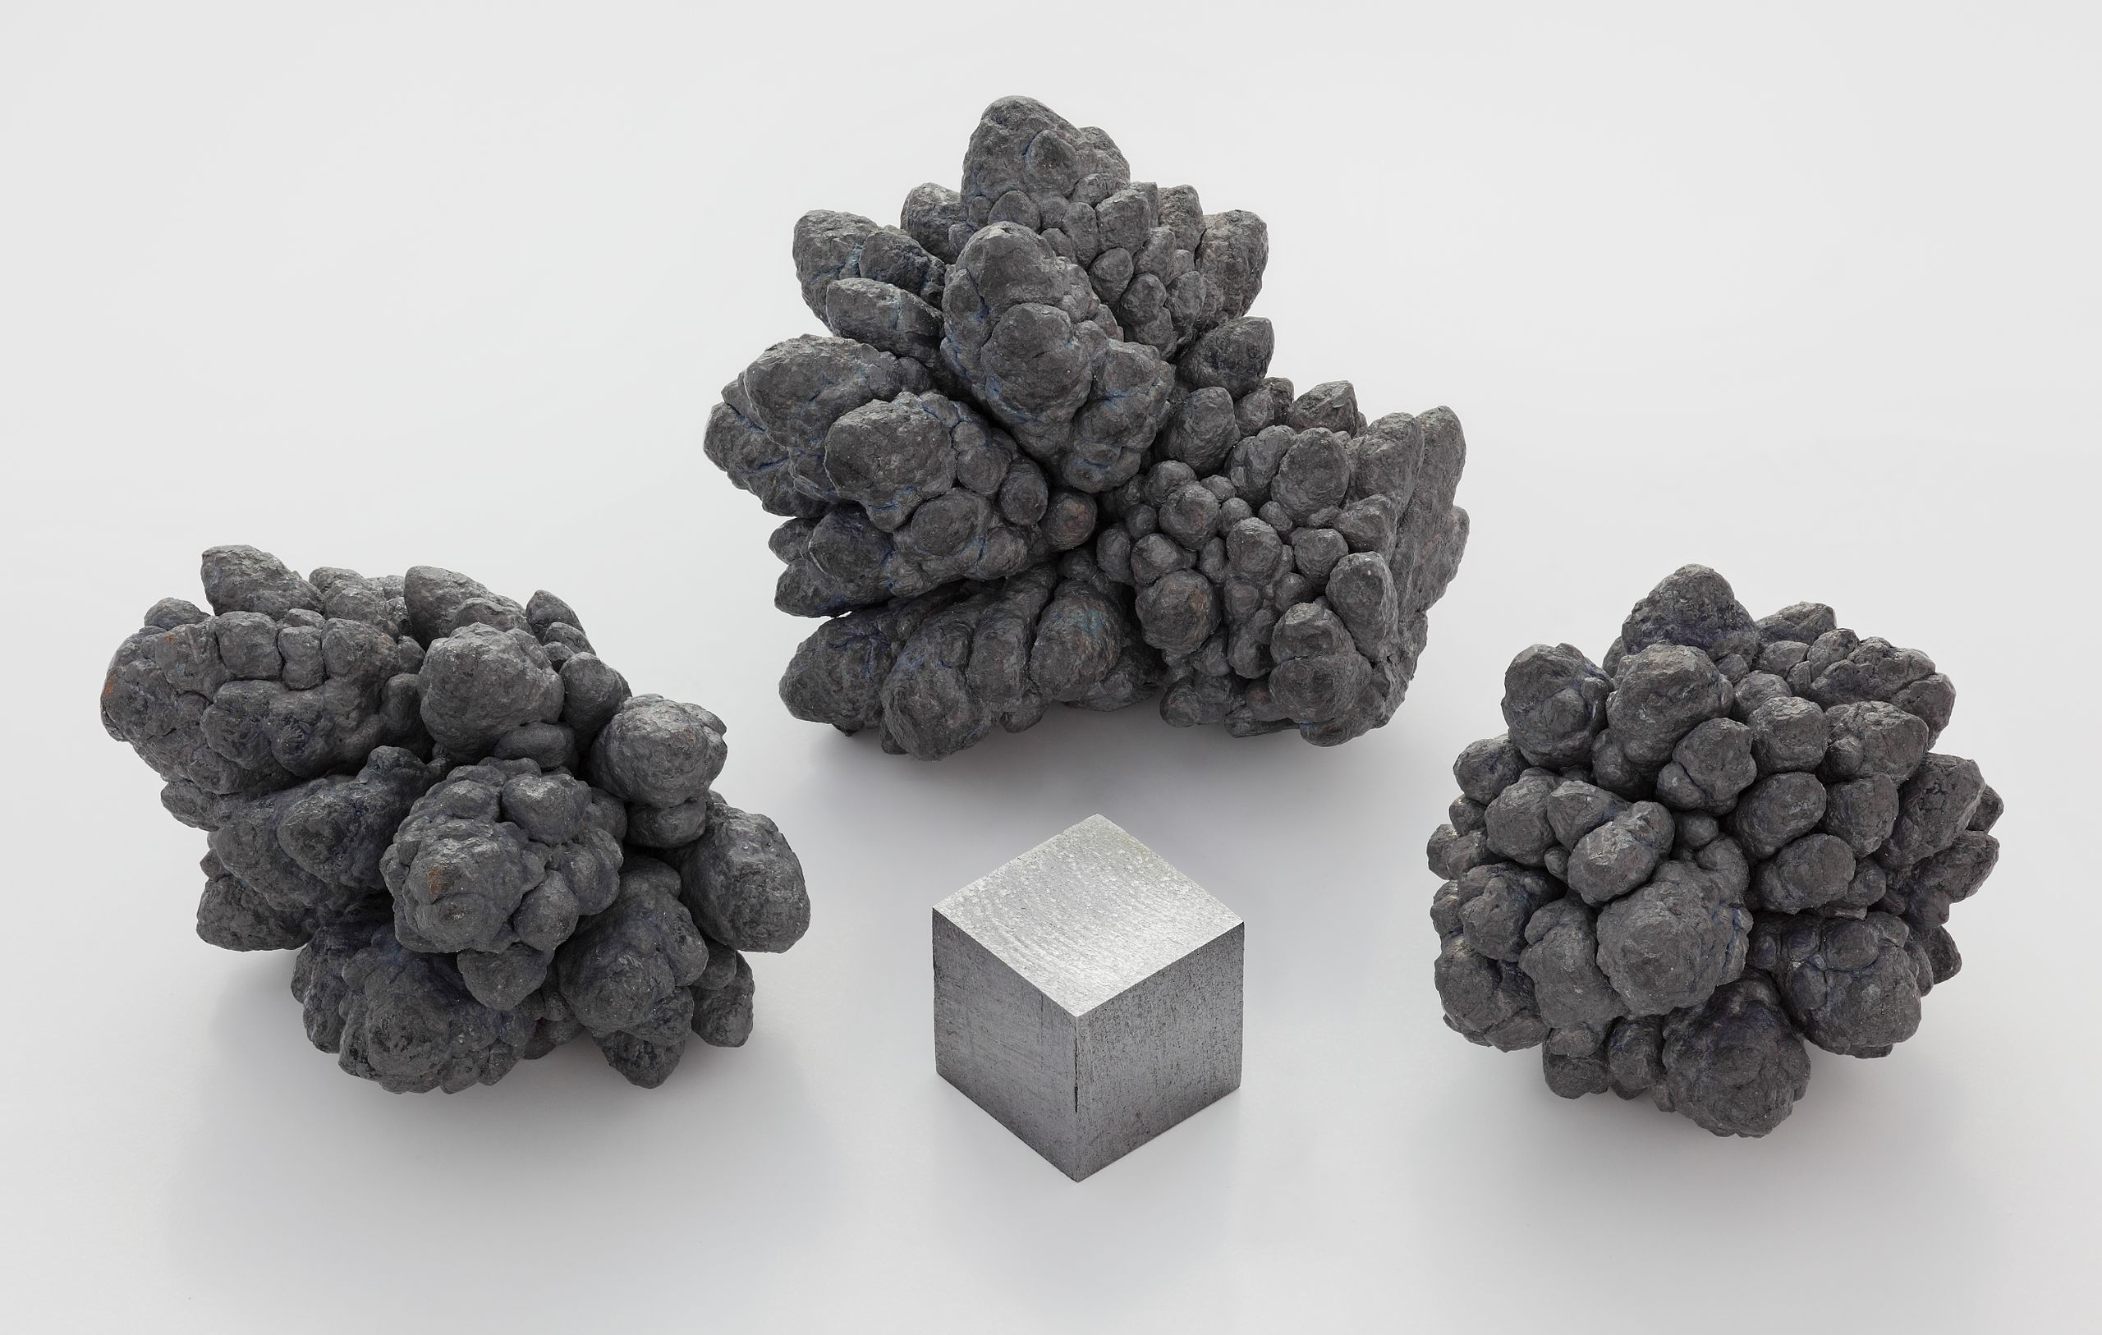
Lead Poisoning Chemistry
Half-lives
Bloodstream: 1 month
Bones: 5–10 years
Brain: 1–2 years
Lead (Pb²⁺) ≈ Calcium (Ca²⁺)
Blocks neurotransmitters
Kill neurons
In children
Inhibits proper brain development
Double whammy
More likely to ingest
More likely to jump blood-brain barrier
Poor nutrition makes it worse

Slide 4
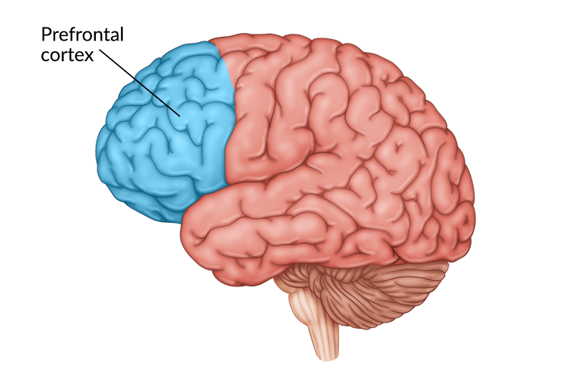
Effects of Lead Poisoning: “System II”
Cognitive stuff
Learning and memory
Impulse control
Attention
Abstract reasoning
Verbal fluency
Reaction time
Fine motor skills
Behavioral outcomes
Violence
Teen pregnancies
School suspensions
Juvenile delinquency

Slide 5

>20 million DALYs (about half of malaria)
$1.5 trillion productivity loss per year
Social costs = $5–10 trillion per year
Who’s fixing it?
NGO (Pure Earth, Lead Exposure Elimination Project) budgets < $10 million per year
That’s it.

Slide 6
Why doesn’t anybody care?
Data, proof
Salience
We’ve gotten this far!

Slide 7
Sources
Gasoline
Aviation fuel
Pipes
Paint
Car batteries
Pots and pans
Spices

Slide 8
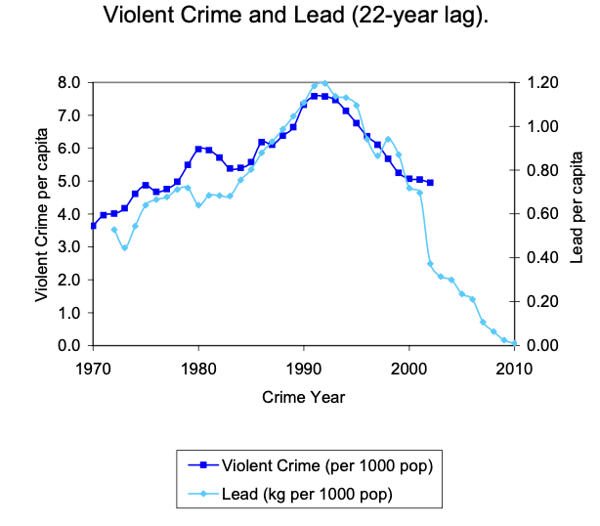
Reyes (2007) “Environmental Policy As Social Policy?”
State level lead, crime measurements by year
22 year lag
–1% lead in gasoline -> –0.8% violent crime
Clean Air Act -> 56% drop

Slide 9
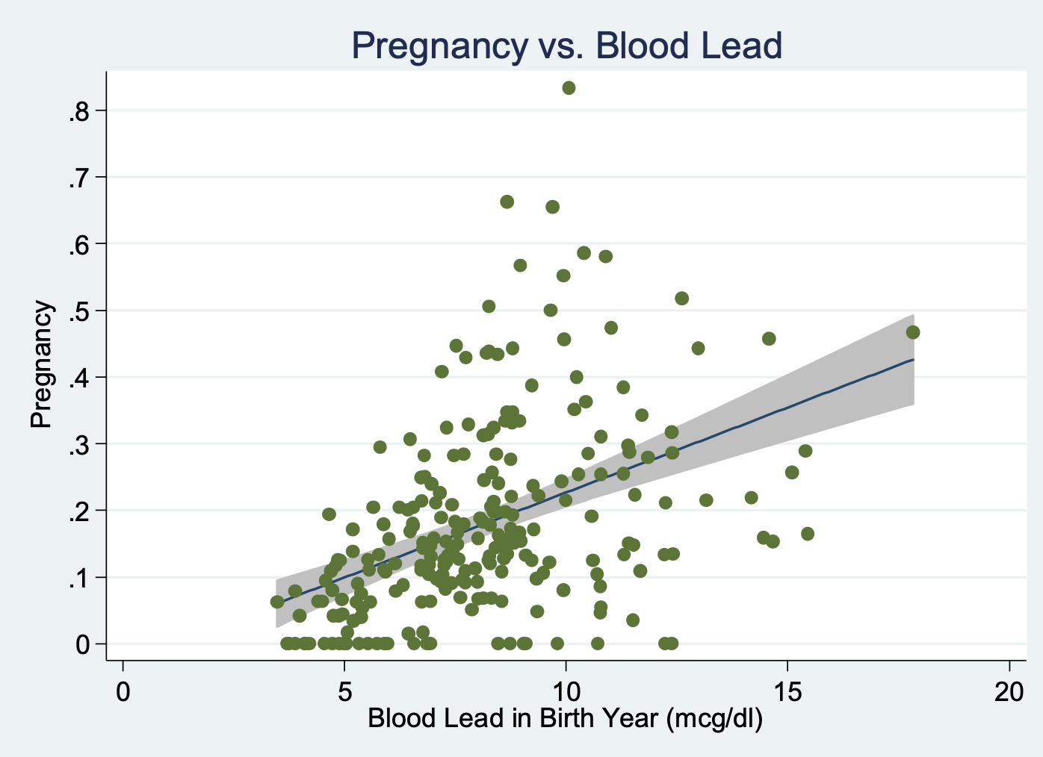
Reyes (2014) “Lead Exposure and Behavior”
Smaller sample
Regress blood lead on gasoline lead
Large panel sample
Predict blood lead using regression
Regress outcomes on predicted blood lead
Significant correlations with
“Behavioral problems”
Teen pregnancy
Substance use
Violence

Slide 10
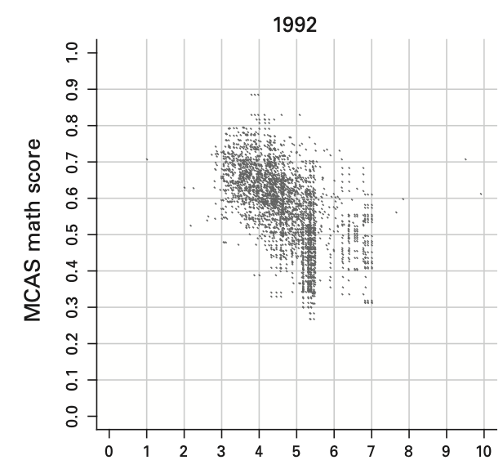
Reyes (2015) “Lead Policy and Academic Performance”
Massachusetts kids
Cross-section
Lead at 0–6 years old
Math, English at 10 years old
Diff-in-diffs
School-level
Bigger drop in lead -> bigger improvement in scores

Slide 11
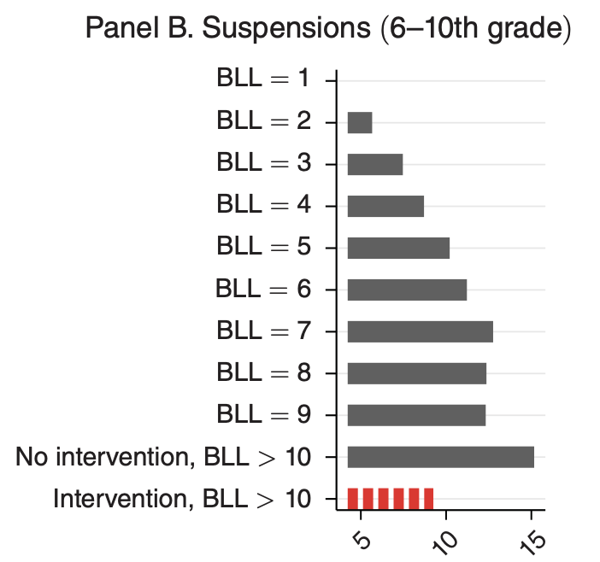
Billings and Schnepel (2018) ”Life After Lead”
North Carolina: All kids tested for lead
Two bad tests -> treatment
State checks home for lead
One bad test -> control
Matched on observables
Results
Small improvement in academics
Large improvement in school suspensions, absences, violent crime

Slide 12
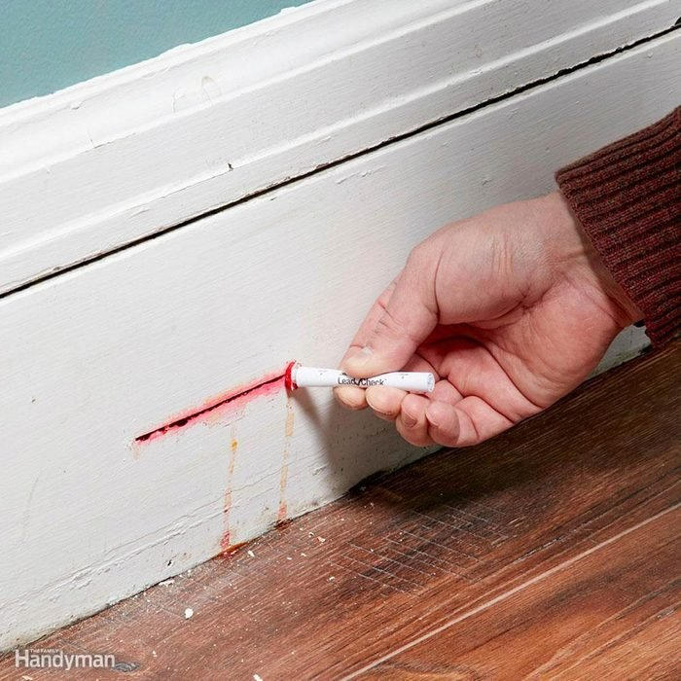
Lead in Paint
More durable, shiny
Pigments
Imported from India, China, UK(!), Canada(!)
Mixed in home country for local sale
Intervention ideas
Send cheap swaps to homes, pay to test, use app to collect data

Slide 13
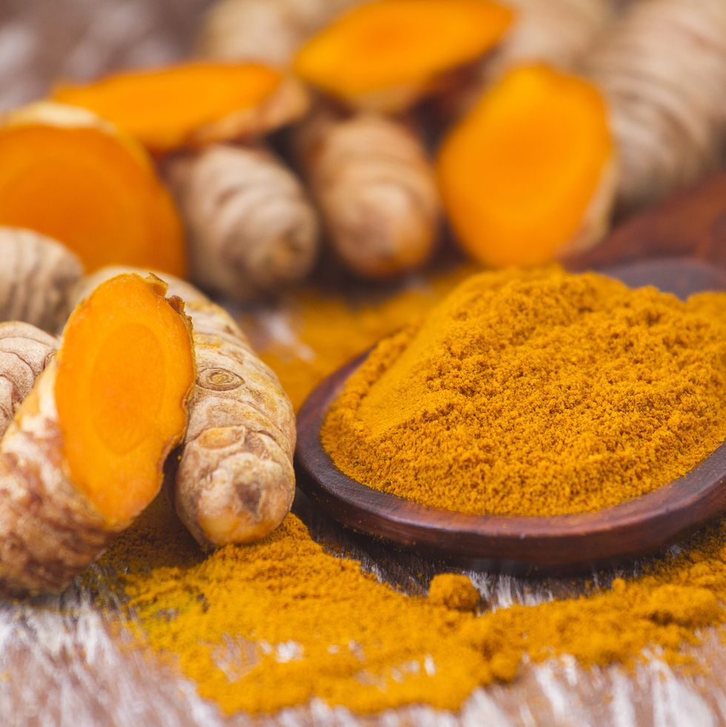
Turmeric
Bangladesh, maybe India
Farmers sell roots to retailers
Yellow die (lead chromate)
Consumers don’t know/care
No enforcement
Intervention ideas
Information
Subsidize equipment
Melons as Lemons

Slide 14
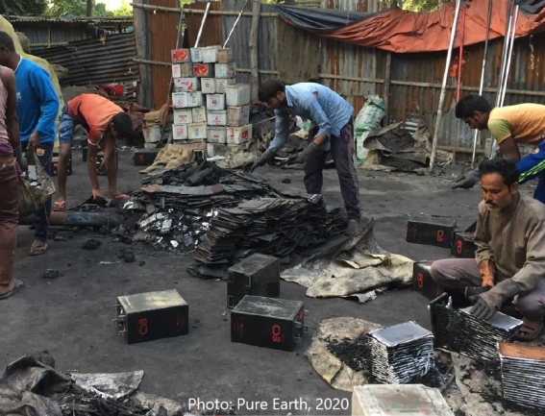
Car Batteries
Need recycling after 5 years
Rip off plastic
Melt lead
Replace plastic, acid
Formal recyclers: safe, clean, expensive, not available in LMICs
Informal recyclers: dangerous, polluting, cheap, anybody’s backyard
Intervention ideas
Buy old batteries, ship them to Europe/US
???

